Slide 1
Objectives
In this lesson, you will learn to:
Identify the types of application architectures
Identify the components of the .NET Framework
List the advantages of the .NET Framework
Identify the features of Visual Basic .NET
Identify the various components of the Visual Studio .NET Integrated Development Environment (IDE)

Slide 2

Types of Application Architectures
Applications may vary from single-tier desktop applications (applications that follow the single-tier architecture) to multi-tier applications (applications that follow the two-, three-, or n-tier architecture).
Single-tier architecture
  A single executable file handles all functions relating to the user, business, and data service layers.

Slide 3
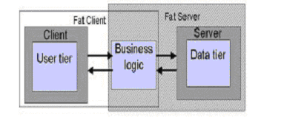
Types of Application Architectures (Contd.)
Two-tier architecture
  Divides an application into the following two components:
    Client
    Server

Slide 4

Types of Application Architectures (Contd.)
Three-tier architecture
  All the three service layers reside separately, either on the same machine or on different machines.
n-tier architecture
  Uses business objects for handling business rules and data access.
  Has multiple servers handling business services.

Slide 5
The .NET Initiative
The introduction of the Internet and its rapid growth in the recent past has led to the development of a number of new technologies.
It has also led to an increase in the number of Web applications.
One of the most important requirements of such applications is the ability to interchange information across platforms and to benefit from the functionality provided by other applications.
In the current scenario, although applications serve organization-specific requirements, they are not interoperable.

Slide 6
The .NET Initiative (Contd.)
Microsoft has introduced the .NET initiative with the intention of bridging the gap in interoperability between applications.
The .NET initiative offers a complete suite for developing and deploying applications, which consists of the following:
  .NET products: Microsoft has already introduced Visual Studio .NET, which is a tool for developing .NET applications by using programming languages such as Visual Basic, C#, and Visual C++.
  .NET services: Microsoft is coming up with its own set of Web services, known as My Services. These services are based on the Microsoft Passport Authentication service, the same service that is used in Hotmail.

Slide 7
The .NET Initiative (Contd.)
  The .NET Framework: It is the foundation on which you design, develop, and deploy applications. Its consistent and simplified programming model makes it easier to build robust applications.

Slide 8
The .NET Framework
The .NET Framework
  Is a collection of services and classes.
  Exists as a layer between .NET applications and the underlying operating system.
  Encapsulates much of the functionality, such as debugging and security services.

Slide 9
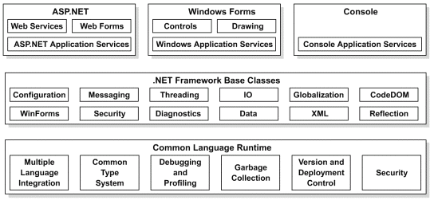
The .NET Framework (Contd.)
The following figure depicts the components of the .NET Framework:

Slide 10
The .NET Framework Base Classes or the .NET Class Framework
The .NET Class Framework
Consists of a class library that works with any .NET language, such as Visual Basic .NET and C#.
Provides classes that can be used in the code to accomplish a range of common programming tasks.
Comprises
  Namespaces: Namespaces help you to create logical groups of related classes and interfaces that can be used by any language targeting the .NET Framework.
  Assembly: An assembly is a single deployable unit that contains all the information about the implementation of classes, structures, and interfaces.

Slide 11
The Common Language Runtime
Provides functionality such as exception handling, security, debugging, and versioning support to any language that targets it.
Can host a variety of languages and offer a common set of tools across these languages, ensuring interoperability between the codes.

Slide 12
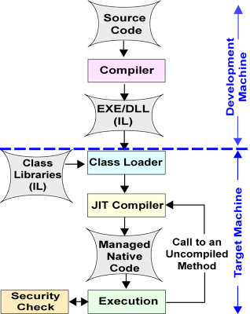
The Common Language Runtime (Contd.)
The following diagram depicts the process of compilation and execution of a .NET application:

Slide 13
The Common Language Runtime (Contd.)
Provides the following features:
  Automatic memory management
  Standard type system
  Language interoperability
  Platform independence
  Security management
  Type safety

Slide 14
Advantages of the .NET Framework
Some advantages of the .NET Framework are:
Consistent programming model
Multi-platform applications
Multi-language integration
Automatic resource management
Ease of deployment

Slide 15
Just a Minute…
1. What are the various components of the .NET Framework?
2. What is an assembly?

Slide 16
Introduction to Visual Basic .NET
Visual Basic .NET is one of the languages that are directed towards meeting the objectives of the .NET initiative of creating distributed applications.
Visual Basic .NET is a powerful object-oriented language that provides features such as abstraction, encapsulation, inheritance, and polymorphism.

Slide 17
Features of Visual Basic .NET
Some of the key features of Visual Basic .NET are as follows:
Inheritance
Constructors and destructors
Overloading
Overriding
Structured exception handling
Multithreading

Slide 18
Visual Studio .NET Integrated Development Environment
The Visual Studio .NET Integrated Development Environment (IDE) provides you with a common interface for developing various kinds of projects for the .NET Framework.
In Visual Studio .NET, an application can be made up of one or more items, such as files and folders. To organize these items efficiently, Visual Studio .NET has provided two types of containers:
  Projects
  Solutions

Slide 19
Visual Studio .NET Integrated Development Environment (Contd.)
The various components of the Visual Studio .NET IDE are:
  The Start Page
  Windows Forms Designer
  The Solution Explorer Window
  The Properties Window
  Toolbox
  The Output Window
  The Task List Window
  The Server Explorer Window
  The Dynamic Help Window

Slide 20
Navigational Features in Visual Studio .NET IDE
  The Class View Window
  The Code and Text Editor Window
The Visual Studio .NET IDE also provides three navigational features:
  Docking
  Tabbed navigation
  Auto hide

Slide 21
Summary
In this lesson, you learned that:
Applications may vary from single-tier desktop applications (applications that follow the single-tier architecture) to multi-tier applications (applications that follow the two-, three-, or n-tier architecture).
In the case of single-tier architecture, a single executable file handles all functions relating to the user, business, and data service layers.
In the case of two-tier architecture, the user and data services are located separately, either on the same machine or on separate machines.

Slide 22
Summary (Contd.)
In the case of three-tier architecture, all the three service layers reside separately, either on the same machine or on different machines.
An n-tier application uses business objects for handling business rules and data access. It has multiple servers handling business services.
Most modern enterprise applications are based on the n-tier application architecture.
In the current scenario, although applications serve organization-specific requirements, they are not interoperable.

Slide 23
Summary (Contd.)
Microsoft has introduced the .NET initiative with the intention of bridging gap in interoperability between applications.
The .NET initiative aims at integrating various programming languages and services.
The .NET initiative offers a complete suite of products and services for developing and deploying applications. In addition, it also provides the .NET Framework, which encapsulates the basic functionality, such as garbage collection, debugging, and security services, that was earlier built into various programming languages.

Slide 24
Summary (Contd.)
The .NET Framework comprises Web Forms, Windows Forms, console applications, .NET Framework Base Classes, and the Common Language Runtime.
Web Forms, Windows Forms, and Console applications pertain to the presentation layer of an application.
Web Forms are used in Web applications for accepting user input and displaying data.
Windows Forms are used in Windows-based applications for providing an interactive user interface.
Console applications can be executed from the command line.

Slide 25
Summary (Contd.)
The .NET Class Framework consists of a class library that works with any .NET language, such as Visual Basic .NET and C#.
The .NET Framework class library is built on the object-oriented nature of the runtime. It provides classes that can be used in managed code to accomplish a range of common programming tasks, such as string management, data collection, database connectivity, and file access.
The .NET Framework class library can be used in a consistent manner across multiple languages and platforms.
The .NET Framework class library consists of namespaces that are contained within assemblies.

Slide 26
Summary (Contd.)
A namespace helps you to create logical groups of related classes and interfaces that can be used by any language targeting the .NET Framework.
An assembly is a single deployable unit that contains all the information about the implementation of classes, structures, and interfaces.
An assembly stores all the information about itself. This information is called metadata and includes the name and version number of the assembly, security information, information about the dependencies, and a list of the files that constitute an assembly.

Slide 27
Summary (Contd.)
The Common Language Runtime (CLR) or the runtime provides functionality such as exception handling, security, debugging and versioning support to any language that targets it.
Some of the features provided by the CLR are as follows:
  Automatic memory management
  Standard type system
  Platform independence
  Security management
  Type safety

Slide 28
Summary (Contd.)
Visual Basic .NET is one of the languages that are directed towards meeting the objectives of the .NET initiative for creating distributed applications.
Some of the key features introduced in Visual Basic .NET are as follows:
  Inheritance
  Constructors and destructors
  Overloading
  Overriding
  Structured exception handling
  Multithreading

Slide 29
Summary (Contd.)
The Visual Studio .NET Integrated Development Environment (IDE) provides you with a common interface for developing Windows and Web applications.
The IDE provides you with a centralized location for designing the user interface for the application, writing code, and compiling and debugging the application.
To organize various items of an application efficiently, Visual Studio .NET has provided two types of containers, projects and solutions.
A project typically contains items that are interrelated. It allows you to manage, build, and debug the items that make up an application.

Slide 30
Summary (Contd.)
A solution usually acts as a container for one or more projects. It allows you to work on multiple projects within the same instance of Visual Studio .NET IDE. A solution also allows you to specify the settings and options that apply to multiple projects.
Some of the components of the Visual Studio .NET IDE are as follows:
  The Start Page
  Windows Forms Designer
  The Solution Explorer Window
  The Properties Window
  Toolbox
  The Output Window

Slide 31
Summary (Contd.)
  The Task List Window
  The Server Explorer Window
  The Dynamic Help Window
  The Class View Window
  The Code and Text Editor Window
In addition to various windows, the Visual Studio .NET IDE also provides three navigational features. These are:
  Docking
  Tabbed navigation
  Auto hide

